Slide 1

Intelligent AI Skill Extraction Dashboard
Automated Skill Gap Analysis Using NLP and BERT
Author: Ravichandra D | Mentor: Mr. Praveen | Date: 30-10-2025

Slide 2

Abstract: Bridging AI and Employment Analytics
Automated Skill Extraction
Semantic Gap Analysis
Interactive Dashboard
Leverages custom NER and SBERT embedding to accurately visualize strengths and missing competencies.
Offers recommendations and management-level reporting through a user-friendly, interactive interface.
Web-based platform that extracts skills from candidate resumes and job descriptions using modern NLP.

Slide 3


Introduction: Revolutionizing Talent Evaluation
Recruitment often relies on manual scrutiny of resumes and job descriptions, which is labor-intensive, error-prone, and inconsistent.
SkillGapAI aims to revolutionize talent evaluation by automating skill extraction and matching procedures with advanced NLP algorithms and deep learning-based similarity analysis.
Goal: To replace manual, inconsistent processes with automated, accurate, and context-aware skill matching.

Slide 4

Core Objectives
Automate Extraction
Extract technical and soft skills from resumes and job descriptions.
Calculate Similarity
Use SBERT model embeddings for semantic similarity analysis.
Identify & Rank Gaps
Accurately identify and rank skill gaps based on importance.
Visualize & Export
Visualize analysis via Streamlit dashboard and export results (CSV, PDF).

Slide 5
Practical Example: Skill Gap Analysis in Action
See how our AI-powered system analyzes a candidate's resume against a job description to identify precise skill matches and critical gaps, providing actionable insights for recruitment.
Candidate & Role Overview
AI-Driven Analysis Results
Candidate Resume Snippet
Experience: Led development of scalable web applications using Python/Django, implemented RESTful APIs, and managed PostgreSQL databases. Proficient in front-end technologies like React and JavaScript. Contributed to multiple Agile projects using Git for version control.
Matched Skills (7)
Job Description: Senior Web Developer
Python, Django
We are seeking a Senior Web Developer with strong Python/Django expertise, experience with modern JavaScript frameworks (React preferred), and database management (SQL, PostgreSQL). Must be proficient in RESTful API design and familiar with cloud platforms (AWS). Experience with Docker and Kubernetes is a plus.
React, JavaScript
PostgreSQL, SQL
RESTful API
Identified Gaps (3)
AWS
Docker
Kubernetes
The system quickly highlights areas of strong alignment and points out specific skills the candidate might need to develop for the role, such as AWS, Docker, and Kubernetes, which were present in the job description but not explicitly in the resume snippet.

Slide 6
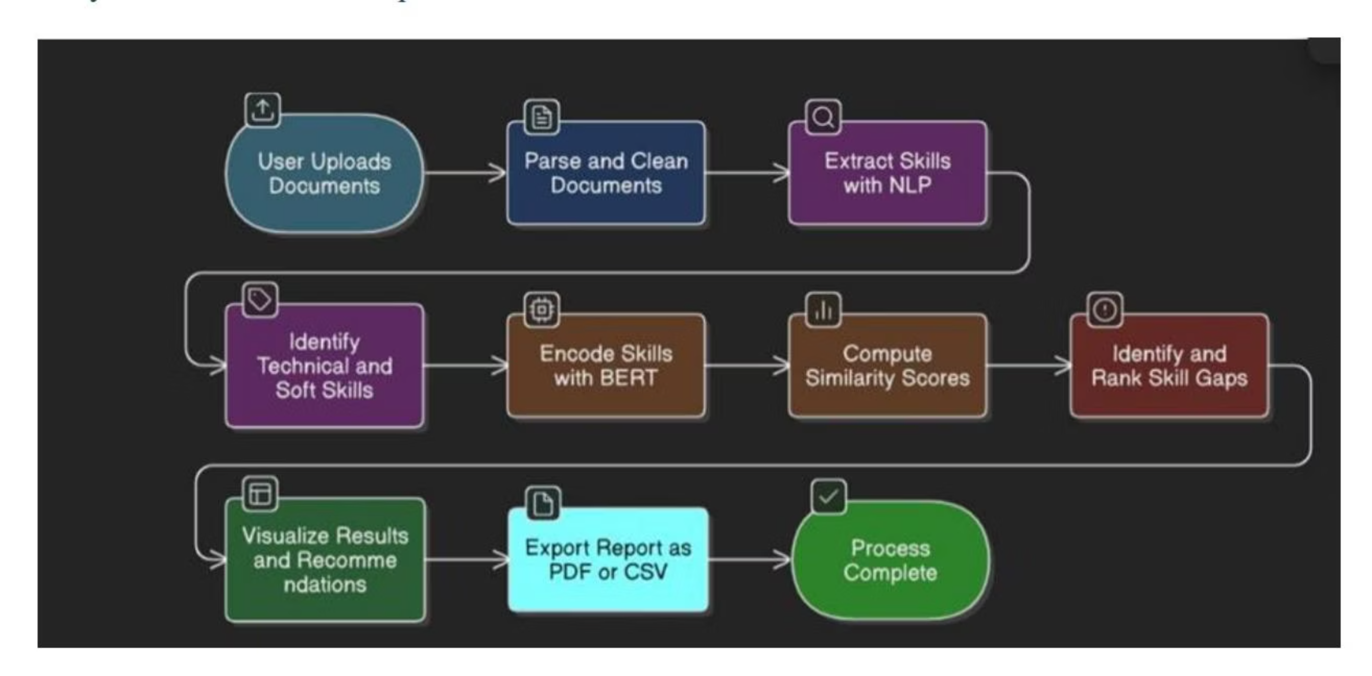
System Architecture: The Modular Pipeline
Data Ingestion
Skill Extraction
SBERT Embedding
PDF, DOCX, TXT uploads and preprocessing.
Custom NER + Keyword matching.
Contextual semantic skill representation.
Gap Analysis
Visualization
Cosine Similarity calculation.
Interactive Streamlit dashboard.

Slide 7
Data Processing & Skill Extraction
Ingestion & Preprocessing
Extraction Techniques
Supports PDF, DOCX, and TXT uploads with robust file validation and error handling.
A hybrid approach ensures comprehensive skill coverage:
Normalization and boilerplate removal.
Optional OCR for scanned PDFs.
spaCy Custom NER
Redaction of contact information.
Trained pipeline identifies both technical (e.g., Python, AWS) and soft skills (e.g., Leadership).
Keyword Extraction
Curated dictionary complements NER, covering niche and high-frequency skills.

Slide 8


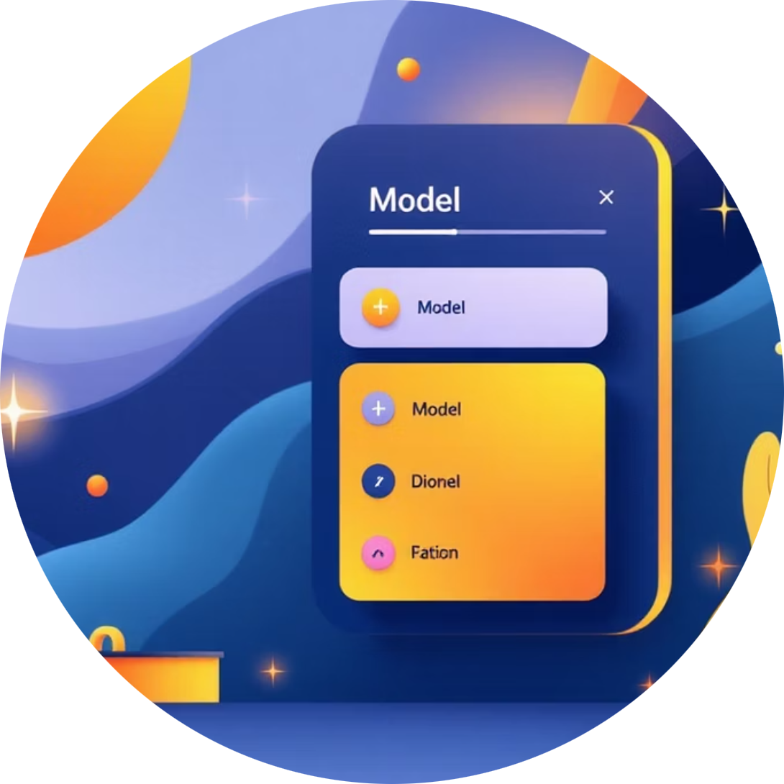
Semantic Matching with SBERT
Contextual Encoding
Performance Optimization
Custom Analysis
Sentence-BERT (SBERT) encodes skills, enabling contextual semantic matching over literal string comparison.
Embeddings for both resume and JD skills are cached to significantly improve system performance.
Users can select alternative SBERT checkpoints for tailored, custom analysis based on domain needs.

Slide 9
Skill Gap Analysis & Visualization
Similarity Calculation
Key Visuals for Reporting
Cosine similarity is computed between skill embeddings. The system generates a similarity matrix and identifies the best-matching resume phrase for each JD skill.
The dashboard uses multiple chart types to present findings clearly:
Radar Chart
Gaps are ranked by importance and missing degree.
Users adjust similarity thresholds for precision/recall balance.
Overall resume vs. JD across defined skill categories.
Heatmap
Detailed skill-to-skill similarity matrix.
Bar Chart
Missing skills ranked by priority.

Slide 10
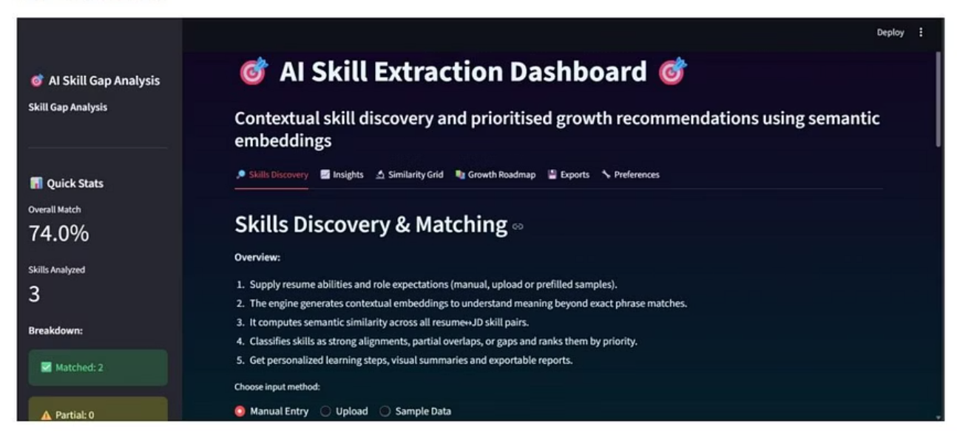
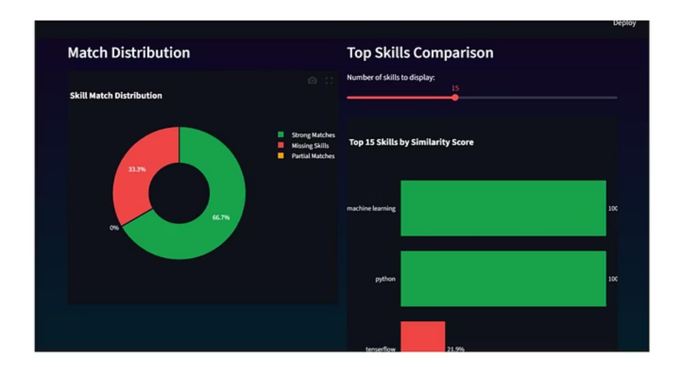
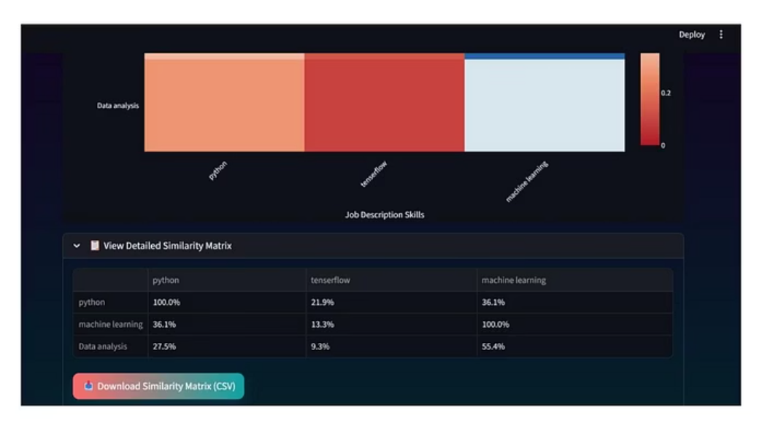
Interactive Streamlit Dashboard
Streamlit provides a smooth, multi-tabbed interface for user interaction:
Sidebar Controls
Document Viewer
Export Options
Upload widget, model selection, and filter adjustments.
Side-by-side highlighted text for easy comparison.
Action buttons to download CSV/PDF outputs.

Slide 11
Challenges and Future Work
Current Challenges
Future Improvements
Handling SSL certificate errors during model downloads.
System Integration
Integrate with external HR systems for seamless data flow.
Parsing badly structured or scanned resumes effectively.
Multilingual Support
Maintaining dictionary relevance for new and emerging skills.
Expand capabilities to support multiple languages.
Advanced Reporting
Add advanced PDF export with embedded charts and improved UI customization.

